Slide 1
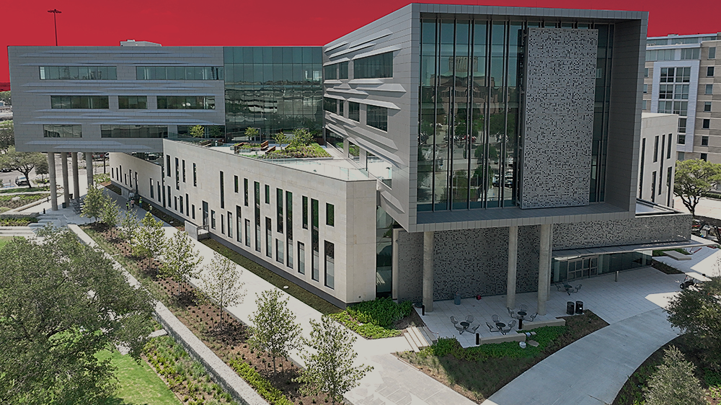

THE HIPPARD NOVICE MOCK TRIAL COMPETITION 2026

Slide 2

SCHEDULE
Learning
Session
February 2nd
Sign Up Period
February 3rd 9am– February 5th @11:59pm
Problem Released
February 6th
Prepare Your Case
February 6th – February 20th (2 Weeks)
Skills Workshop
February 12th @ 12 pm
Competition
February 20th – February 22th
Turn-in Assignment
March 1st

Slide 3
COMPETITION DETAILS

Slide 4





PARTNERS
2-PERSON LAWYER TEAMS, SIGN UP AS A TEAM!
CAN BE ANY 1L LAW STUDENT AT UHLC.
ALL WELCOME!
IF YOU ARE LOOKING FOR A PARTNER, PLEASE LET ME KNOW!
YOU MUST BE AVAILABLE FOR THE FULL WEEKEND,
NO DROPPING OUT BEFORE FINALS
YOU WILL PREPARE BOTH SIDES OF THE CASE
PLAINTIFF AND DEFENSE

Slide 5
WITNESSES
Each team is required to have two witnesses
Witnesses do not have to be law students
Please let me know if you do not have a witness, I can help
Witnessing is a great way to participate if you do not want to compete

Slide 6






MOCK TRIAL OVERVIEW
MOTIONS IN LIMINE
OPENING STATEMENT
PLAINTIFF’S CASE IN CHIEF
DEFENDANT’S CASE IN CHIEF
CLOSING STATEMENTS
REBUTTAL

Slide 7



RULES
Split the components evenly
You are timed
Don’t read
You are scored on professionalism
You must do at least one cross and one direct in every round
You cannot do both the closing and opening in a round
5 mins for MIL/70 mins for case in chief, not including objections
Memorize what you can, but notes are OKAY
You are expected to use the well.
Dress professionally
Address the judge as “Your Honor” and remember to stand

Slide 8

MOCK TRIAL COMPETITION STRUCTURE

Slide 9

CALLING THE CASE
INTRODUCE YOURSELF
HOUSEKEEPING
Plaintiff goes first, then defense,
“Good morning, your Honor. (Name) and (Name), representing (the plaintiff/defendant. )
Optional, but helpful
Ask about pre-marking exhibits, moving about the well, invoking the rule etc.

Slide 10
MOTIONS IN LIMINE
STRUCTURE
Limited to 3 parts per side
Remember that you only have 5 minutes!
Either partner can argue
WHAT IS A MIL?
Motions to exclude evidence that is too prejudicial to just object to when they come up
EXAMPLE: “Isn’t it true that you killed someone before?”
MIL’s are purely preliminary -- the judge can always change their mind
If something is excluded, you can still ask to approach and bring it up later
MAKING THE MOTION
Explain the evidence that you want excluded and under what rule of evidence
Keep it short!
Give context- the judge knows nothing about the case

Slide 11
OPENINGS
5-8 minutes
START WITH A HOOK AND A HEADLINE
Something catchy that explains your theme
“if the glove doesn’t fit, you must acquit”
TELL A STORY ARRANGED AROUND THE THEORY OF THE CASE
Present tense and easy to understand
Don’t argue
ANTICIPATE THE OTHER SIDE
Don’t hide evidence
Get in your main points
DISCUSS THE BURDEN OF PROOF
By a preponderance of the evidence
CALL FOR ACTION
By the end of this trial, you will find the only result that the evidence supports, and justice demands

Slide 12

DIRECTS
Ask open ended questions – no leading the witness
Let the witness tell the story. You are just there to keep the witness on topic
Prepare your witness well. Make sure they know the facts
Personalize your witness to give them credibility
Keep your witness organized
Listen to your witness’s answers, follow up if needed.
Anticipate cross questions and stay ahead of it.

Slide 13
CROSSES
You are the star of the show
The attorney should be talking most of the time
Tell the story through the questions, not the answers
Leading questions only!!!
Keep the witness from talking too much about their side
Show that you are in control
Ask questions that you KNOW have “yes” or “no” answer
Make your case
Get evidence that supports your case theory
Discredit the witness
Attack the witness’s testimony
Be organized
Know the facts
Don’t write out your questions but use an outline
Don’t let the witness get you off topic

Slide 14
CLOSINGS
Use your theme to help tell your story
Reuse and repeat your hook from your opening
Bring it all together
Incorporate what has come in through the course of the trial
Reference specific testimony and exhibits
Argue
Attack the other side of the case
Witness credibility
Key evidence
Was the burden of proof met?
What was/wasn’t proven?
End with a request for a verdict

Slide 15
HELPFUL REMINDERS
Be respectful, be professional
Judges could be your potential employers!
Don’t be a jerk (witnesses too!)
Please play fair and within the rules
Don’t make up facts
Have a good time!

Slide 16
REGISTRATION

Slide 17
HOW TO SIGN UP
STEP 1
FIND A PARTNER
STEP 2
PAY THE ENTRY FEE
STEP 3
FILL OUT THE REGISTRATION FORM

Slide 18



PAYMENT
Pay to the Advocates Paypal
@TheAdvocatesatUHLC
Save your confirmation number
Entry Fee per team
$20 per team for members,
$100 per team for non-members,
$60 per team for a member/non-member team
Must pay by deadline
February 5th - No exceptions (BUT, keep in mind the competition will likely fill up before this last day to register)
Late payment means that you will not receive the problem!

Slide 19
REGISTRATION
Fill out the google form w/ your paypal number
One form and one payment per team
Once you register you must compete
If you drop out there will be consequences
Your space is not reserved until you both paid and completed the registration form
Further instructions on the Advocates website
Registration opens 2/3 at 9 am

Slide 20




RECEIVING CLASS CREDIT
Must fill in the Blakely Credit Petition: https://www.law.uh.edu/blakely/credit-petition.asp
Regular Tuition Fee (you’re paying for a credit)
You must show a good faith effort – you cannot waive a round.
Submit 5 Pages (3 of 5) of written work products by email, no later than Sunday March 1, 2025 at 11:59pm

Slide 21

ANY QUESTIONS?
Sarah Overcash
sovercash@uh.edu

