Slide 1


PRESENTS
The 2026 Lorance Thompson Contract Drafting and Negotiation Competition

Slide 2
LORANCE & THOMPSON, P.C.
Top-ranked Texas law firm
Focus: auto & workers’ comp, commercial litigation, torts (products liability, med mal, employment, transportation, construction, insurance)
IP & specialty: copyrights, trademarks, pharmaceutical, premises liability, toxic tort, environmental & automotive defense
Also handled corporate law
Now merged with Mayer LLP

Slide 3
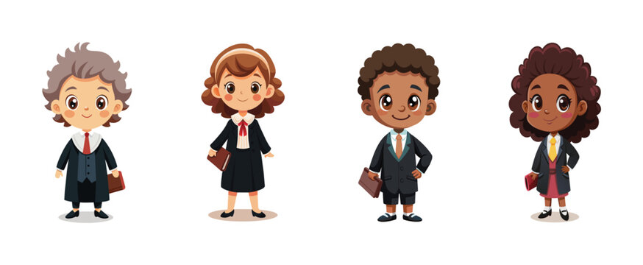
WHO
All future attorneys in this room
Transactional
Litigation
Current and future UHLC ADR team members
Anyone wanting to earn a competition credit
more on this later…
Open to all UHLC students
**You MUST have a partner in order to register
The Advocates will provide a live shared excel sheet to facilitate pairs between anyone without a partner, but it it your responsibility to find one

Slide 4
WHAT, WHEN, WHERE
Intramural ADR competition (2 Parts – MUST Complete Both)
(1) Negotiation:
Each team acts as legal counsel representing their client’s interests in two-party, conference style negotiation rounds. The goal for each side is to attain all the terms of a settlement that may be enshrined in a contract.
Saturday, April 11, 2025 from 8:00 AM – 5:30 PM @ UHLC in person (to allow sufficient time for check-in)
**All teams must complete in preliminaries at the minimum to be eligible for competition credit**
(2) Contract Drafting:
Each team will be assigned a problem from one of their rounds. They must use the actual terms of the settlement reached in the round to draft a contract.
Due April 17, 2025 via email @ 11:59 PM
**All teams must submit a good-faith effort contract (regardless of whether your team moved on past preliminaries) to be eligible for competition credit**

Slide 5
WHY PARTICIPATE?
Cash prizes!!
There are 2 opportunities to win (1 winning team for Contract Drafting and 1 for Negotiation)
Great learning and networking opportunity
We’ve built in some extra time between rounds for judge’s feedback… use it! Ask questions, seek advice, incorporate feedback into next rounds as you go
Get to know your judges and let them get to know you
Provides practical legal skills, useful for resumes, interviews, etc.
1 hour of non-substantive competition credit by:
Making a good-faith effort in both parts of the competition
Easiest 1 hour of credit you will ever earn in law school!!

Slide 6
PROBLEM SETS
General Information:
Same for both parties
Conveys context of the problem and related events
States which Critical Issue MUST be resolved by the end of the negotiation
Confidential Information:
Differs for each side
Provides additional detail particular to your client
Neither side begins the negotiation with the other side’s Confidential Information

Slide 7

Negotiation: Structure
24 teams of 2
4 rounds total
Prelim: all 24 teams
Quarterfinals: 12 teams
Semifinals: 6 teams
Final: 2 teams
Each active round = 65 minutes
50 minutes speaking
15 minutes scoring/feedback
Total = ~1.5 hours per segment

Slide 8
SAMPLE NEGOTIATION BREAKDOWN
Action | Timing
Initial Introductions | 2 minutes
Statement of the Issues – Side A | 3 minutes
Statement of the Issues – Side B | 5 minutes
Option Generation | 10 minutes
Option Evaluation | 15 minutes
Agreement Identification | 10 minutes
Summary of Agreement | 3 minutes
Transition Out | 2 minutes
Total Time Allocated to a Flight | 50 minutes

Slide 9
NEGOTIATIONS SCHEDULE Saturday, April 11th
Time | Event
8:00 am to 8:30 am | Competitor check-in and processing
8:30 am to 10:00 am | Preliminary Round
10:00 am to 10:30 am | Break + quarter finalists check-in and processing
10:30 am to 12:00 pm | Quarter-final Rounds
12:00 pm to 1:00 pm | Lunch Break + announce semi finalists
1:00 to 1:30 | Semi finalists check-in and processing
1:30 to 3:00 pm | Semi-final Rounds
3:00 pm to 3:30 pm | Break + announce finalists
3:30 pm to 5:00 pm | Final Round

Slide 10
NEGOTIATIONS SCORING
Confidential information
No agreement on at least one term = Both sides lose that round
Performance Score
Preparedness
Adaptability
Outcomes
Relationship Management
Teamwork
Self-Evaluation
Side A
Side B

Slide 11
Pt. 2: Contract Drafting
Written contract guidelines
No formal length requirement
Must include all the essentials of a standard K
Both partners must contribute a good faith effort regardless of whether you are claiming a credit
This is part of the competition; not optional
Review tech policy below
Due @ 11:59 PM on Friday, April 18th
Reviewed for good faith efforts and timeliness
Contract drafting winner and runner up announced on April 19th
All winners will receive their prizes soon after this date

Slide 12
CONTRACT DRAFTING SCORING
Written Submission
Adaptability and compromise
Client focused
Incorporate verbal settlement terms
Is this something you would allow your client to sign?
Teamwork

Slide 13
PREPARATION
Easiest burden of UHLC intramural competitions
Fact patterns released 4/6/2025
No pre-competition papers or reports
Teams receive 3–4 fact patterns; be prepared for all
Round-specific facts and sides released day of
No outside research (including professors/practitioners)
Know your scenario and client Identify BATNA, reservation price, positions, and interests
Estimate opponent’s BATNA, reservation price, positions, and interests
Focus on creating value in the negotiation

Slide 14
KEY CAUTIONS
Arrive on time in professional courtroom attire, fully prepared and informed
No communication between observers and competitors; violation = automatic loss
Judges are silent observers; teams must manage their own pacing (50 minutes)
Late or absent teams automatically forfeit the round
Follow all additional instructions from the Competition Packet and check-in

Slide 15
TECH POLICY
NO electronic usage by participants inside competition rooms during rounds
You may use your phones/watches to keep time as a regular clock
You may discuss an amiable strategy with opposing counsel during the round to manage time
You may NOT set a series of timers to remind you
No artificial intelligence usage is permitted on the final contract: doing so will result in an automatic disqualification and a referral to admin for an honor code violation

Slide 16
REGISTRATION & HOUSEKEEPING
Application, learning lunch slides and general information:
http://theadvocatesatuhlc.org/competitions/lorance-thompson-negotiation-competition/
Complete only ONE application per team
Registration opens Friday March 27rd and closes once all spots are filled or on April 3rd at 5PM (whichever occurs first)
Registration for this competition has limited spots and usually fills up quickly.
Make sure you have a partner and one of your Paypal accounts working before registration opens (you will need to put the transaction ID
No exceptions will be made once the spots are filled.
Competition Fee Structure
(1) $20 if both team members are also Advocates members
(2) $100 if both team members are non-Advocates members
(3) $60 for half and half
Must pay fee via PayPal under ONE transaction ID per team.
To receive credit, you must (1) satisfactorily compete in the competition, (2) complete a Competition Credit Petition, and (3) register/pay as you would for a normal, 1-hour class.
Notes:
The cost is $10 for members and $50 for non-members.
However, you must register as a team, so the options will include:
2 Member Competitors: $20
2 Non-Member Competitors: $100
1 Member & 1 Non-Member Team: $60

Slide 17
TIPS
Know your fact patterns thoroughly and use secret information strategically
Print materials and be ready to take handwritten notes
Contract portion is based on one round’s settlement—identify key terms early and prioritize accordingly
One person speaks at a time; maintain a respectful tone
Collaborate—less combative approach yields better outcomes
Scoring is holistic; best settlement ≠ highest score

Slide 18
Useful Links
What is BATNA? https://www.pon.harvard.edu/daily/batna/frustrated-by-an-uninformed-negotiator-consider-your-batna/
What is a Reservation Point? https://www.pon.harvard.edu/daily/negotiation-skills-daily/resolve-conflict-by-asking-the-right-questions/
Negotiation Strategies https://www.pon.harvard.edu/daily/negotiation-skills-daily/six-strategies-for-building-trust-in-negotiations/

Slide 19
QUESTIONS?
Gabby Sterritt, Competition Director
gesterri@cougarnet.uh.edu

