Slide 1
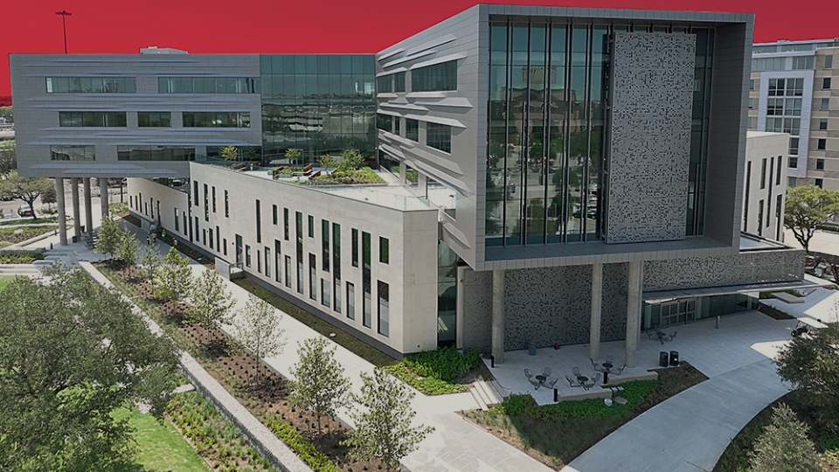
The 2026 James J. Hippard Open Mock Trial Competition
Lunch & Learn

Slide 2

Saturday 9/19!
Sunday 9/20!
Friday 9/18!
12:30
8:30
9:00
12:30
4:30
4:30
Dates to Remember!
Competition Schedule!
Registration Opens
  Friday, Sept. 4 – 12 pm
Registration Closes
  Monday, Sept. 7 – 5 pm
Problem Released
  Monday, Sept. 7 – 5 pm (or once slots are full)
Preparation Time
  From Problem Release Time – Day of Competition
Competition
  Friday, Sept. 18 – Sunday, Sept. 20
Q
3
1
2
S

Slide 3
Preliminary
Rounds
All Teams Compete
Dates to Remember!
Competition Schedule!
Registration Opens
  Friday, Sept. 4 – 12 pm
Registration Closes
  Monday, Sept. 7 – 5 pm
Problem Released
  Monday, Sept. 7 – 5 pm (or once slots are full)
Preparation Time
  From Problem Release Time – Day of Competition
Competition
  Friday, Sept. 18 – Sunday, Sept. 20
Saturday 9/19!
Sunday 9/20!
Friday 9/18!
Round
A.M.
A.M.
P.M.
P.M.
12:30
Q
8:30
Round
9:00
12:30
3
4:30
1
4:30
Round
2
S

Slide 4
Sunday 9/20!
Competition Schedule!
P.M.
Friday 9/18!
P.M.
1
Round
12:30
Playoff
Rounds
Qualifying Teams Compete
Quarter-Finals
Preliminary
Rounds
All Teams Compete
A.M.
2
Semi-Finals
Round
4:30
Saturday 9/19!
A.M.
Round
3
8:30
12:30
9:00
4:30
Q
S

Slide 5
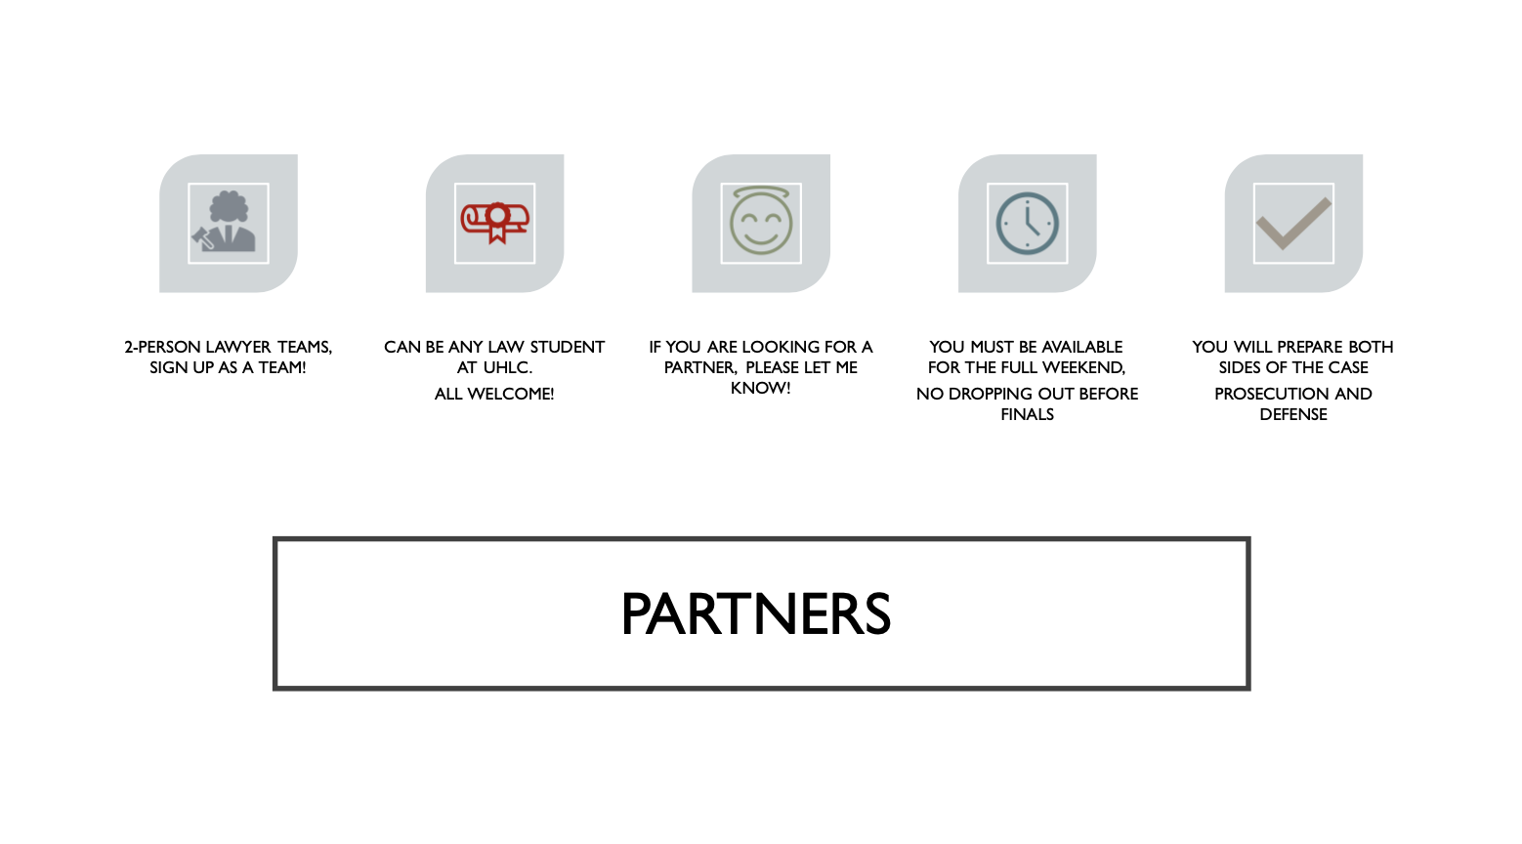
Friday 9/18!
Competition Schedule!
P.M.
Saturday 9/19!
Round
Criminal Case!
1
Playoff
Rounds
Qualifying Teams Compete
Quarter-Finals
12:30
Round
Semi-Finals
2
4:30
A.M.
Sunday 9/20!
3
Round
9:00
In-Person at UHLC!
8:30

Slide 6
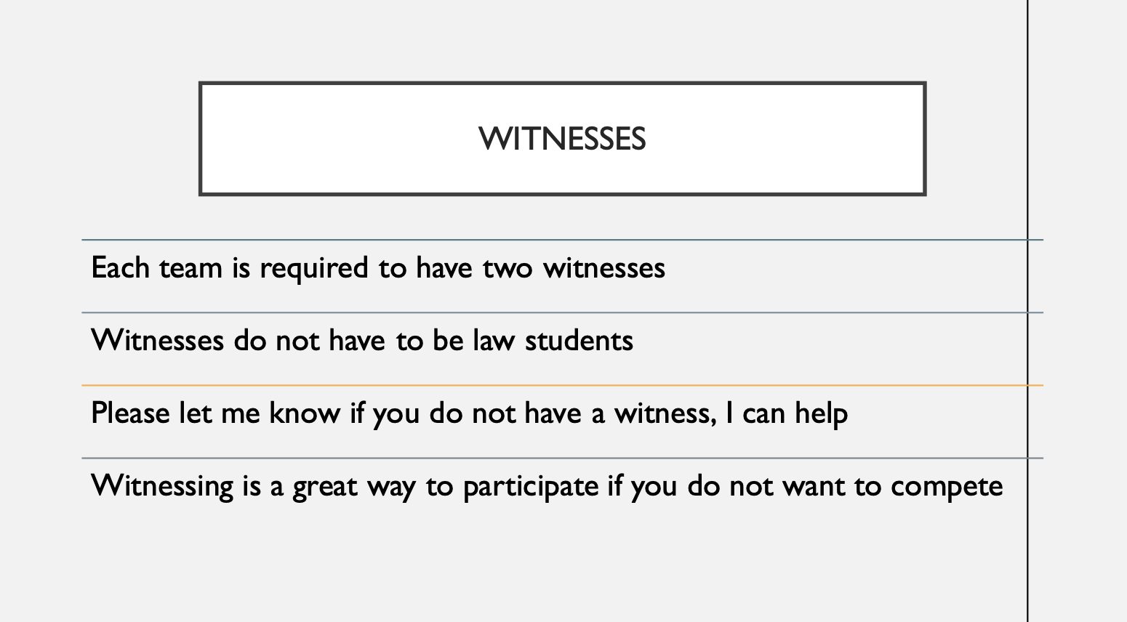
Friday 9/18!
Format!
Saturday 9/19!
Round
Criminal Case!
1
Playoff
Rounds
Qualifying Teams Compete
Quarter-Finals
12:30
Semi-Finals
4:30
Round
2
P.M.
Witnesses can be anyone; they don’t have to know anything about law!
A.M.
Sunday 9/20!
Round
9:00
3
In-Person at UHLC!
8:30

Slide 7

Friday 9/18!
Format!
Saturday 9/19!
Round
Criminal Case!
1
Playoff
Rounds
Qualifying Teams Compete
Quarter-Finals
12:30
Semi-Finals
4:30
Round
2
P.M.
Witnesses can be anyone; they don’t have to know anything about law!
A.M.
Sunday 9/20!
Round
9:00
3
In-Person at UHLC!
Thank you to our sponsors!
8:30

Slide 8
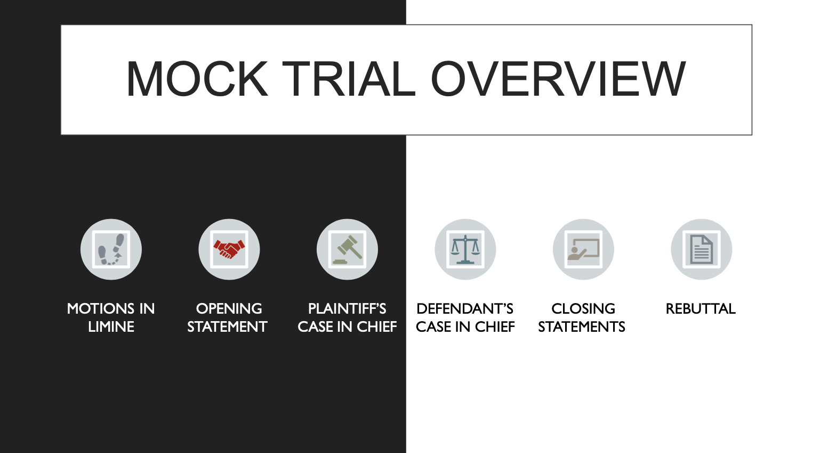
Format!
12:30
Thank you to our sponsors!
Witnesses can be anyone; they don’t have to know anything about law!

Slide 9
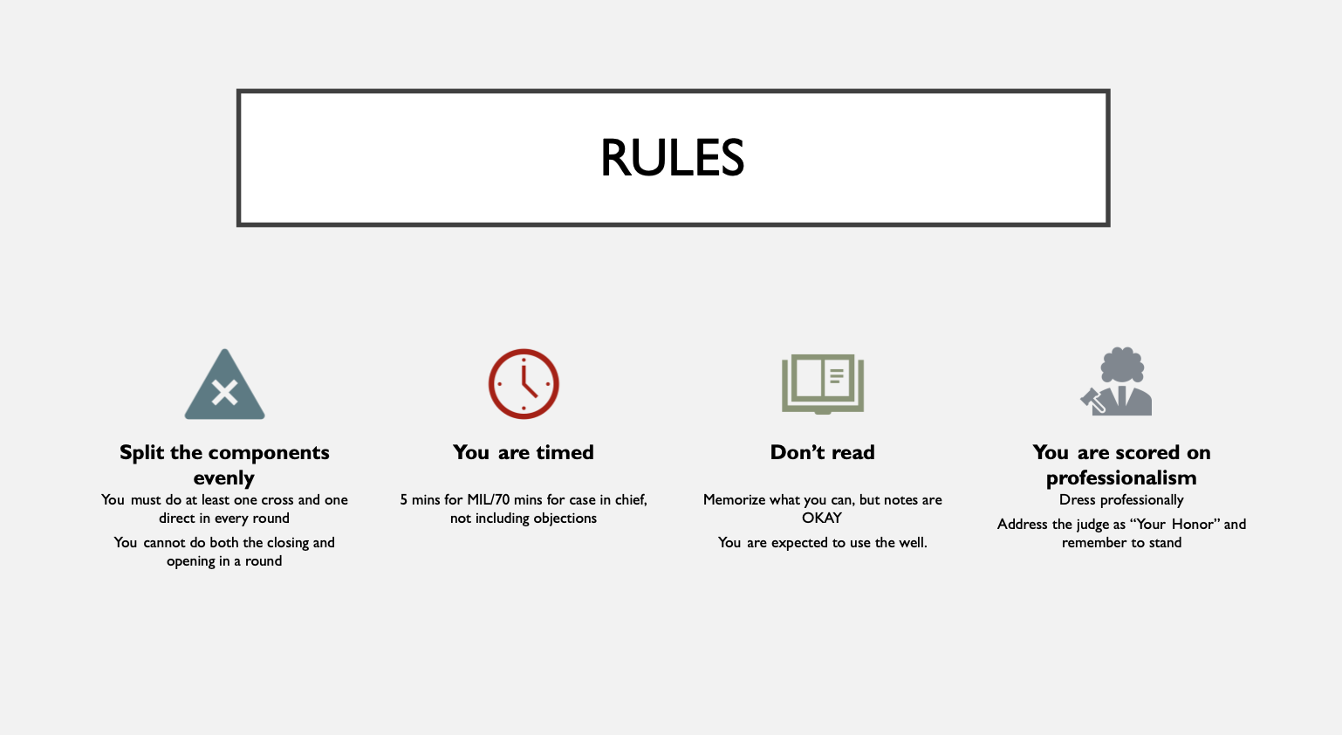
Format!
12:30
Witnesses can be anyone; they don’t have to know anything about law!
Thank you to our sponsors!

Slide 10
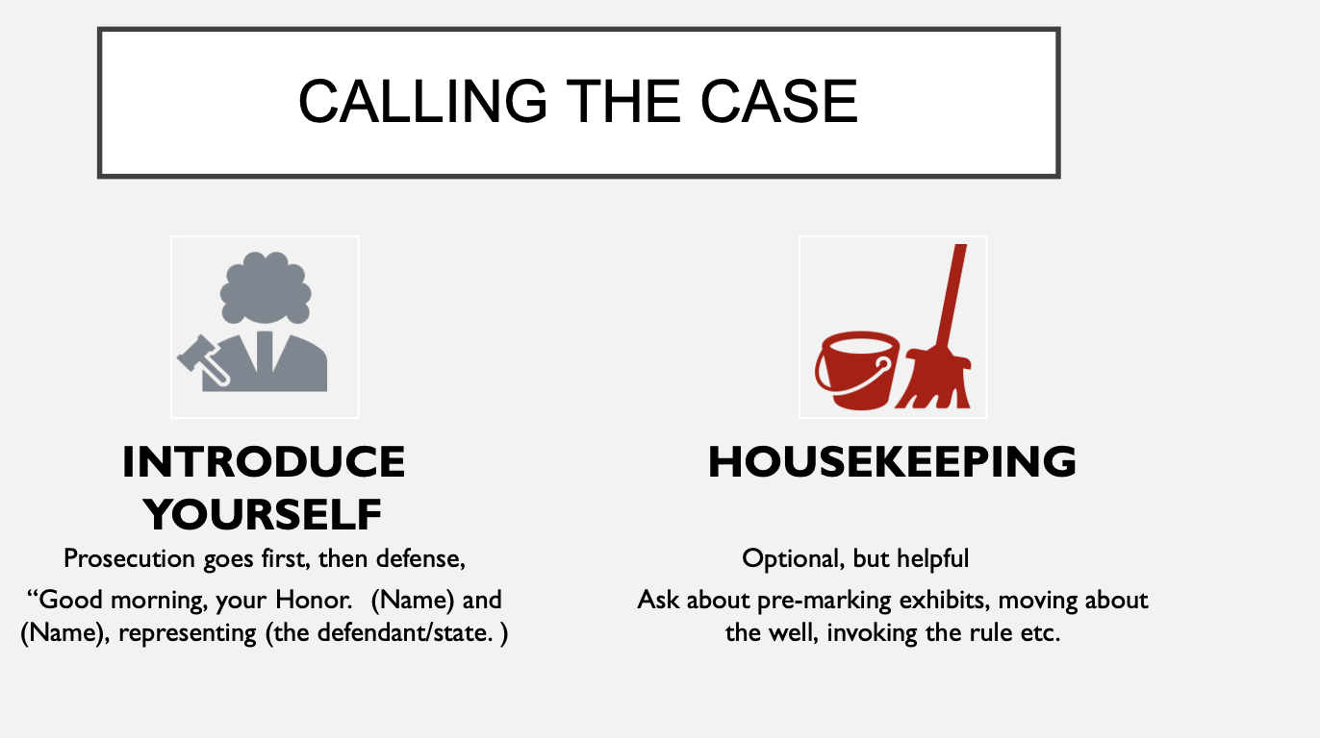

12:30
Witnesses can be anyone; they don’t have to know anything about law!
Thank you to our sponsors!

Slide 11
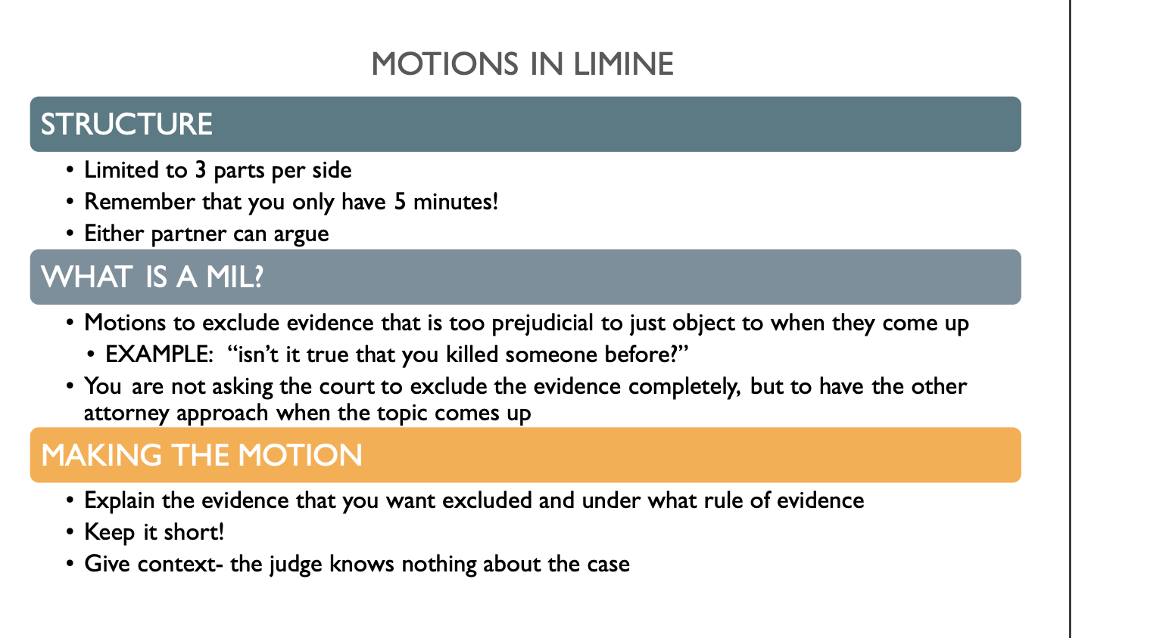
12:30
Witnesses can be anyone; they don’t have to know anything about law!
Thank you to our sponsors!

Slide 12
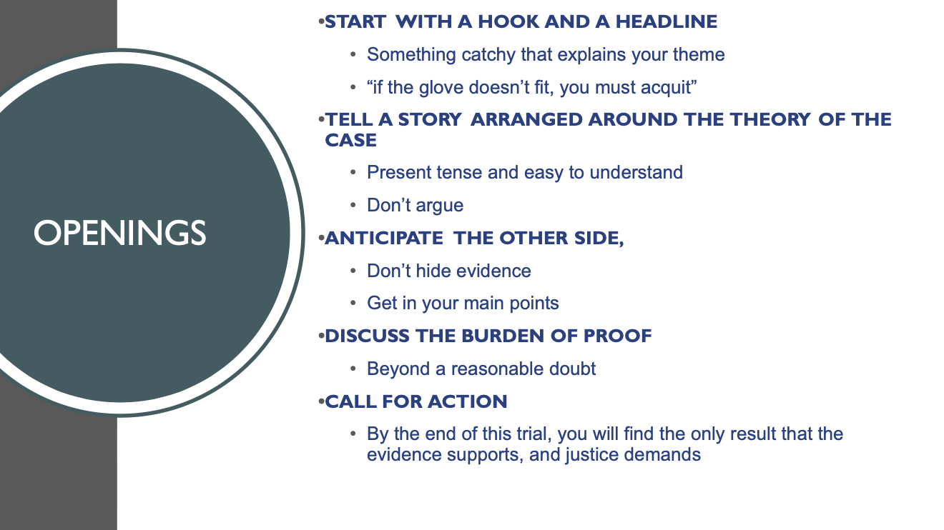
12:30
Witnesses can be anyone; they don’t have to know anything about law!
Thank you to our sponsors!

Slide 13
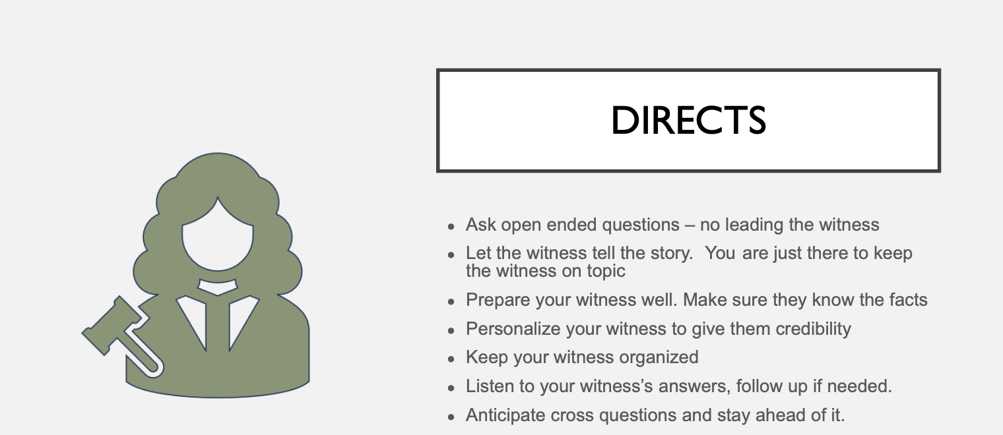
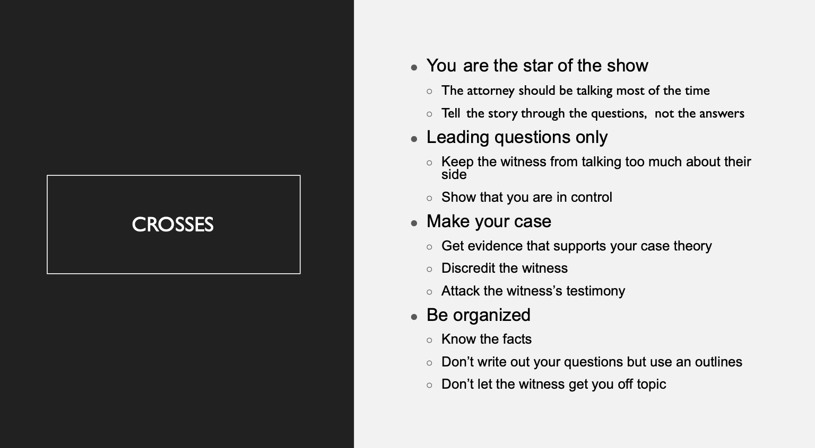
12:30
Witnesses can be anyone; they don’t have to know anything about law!
Thank you to our sponsors!

Slide 14
12:30
Witnesses can be anyone; they don’t have to know anything about law!
Thank you to our sponsors!

Slide 15
12:30
Witnesses can be anyone; they don’t have to know anything about law!
Thank you to our sponsors!

Slide 16
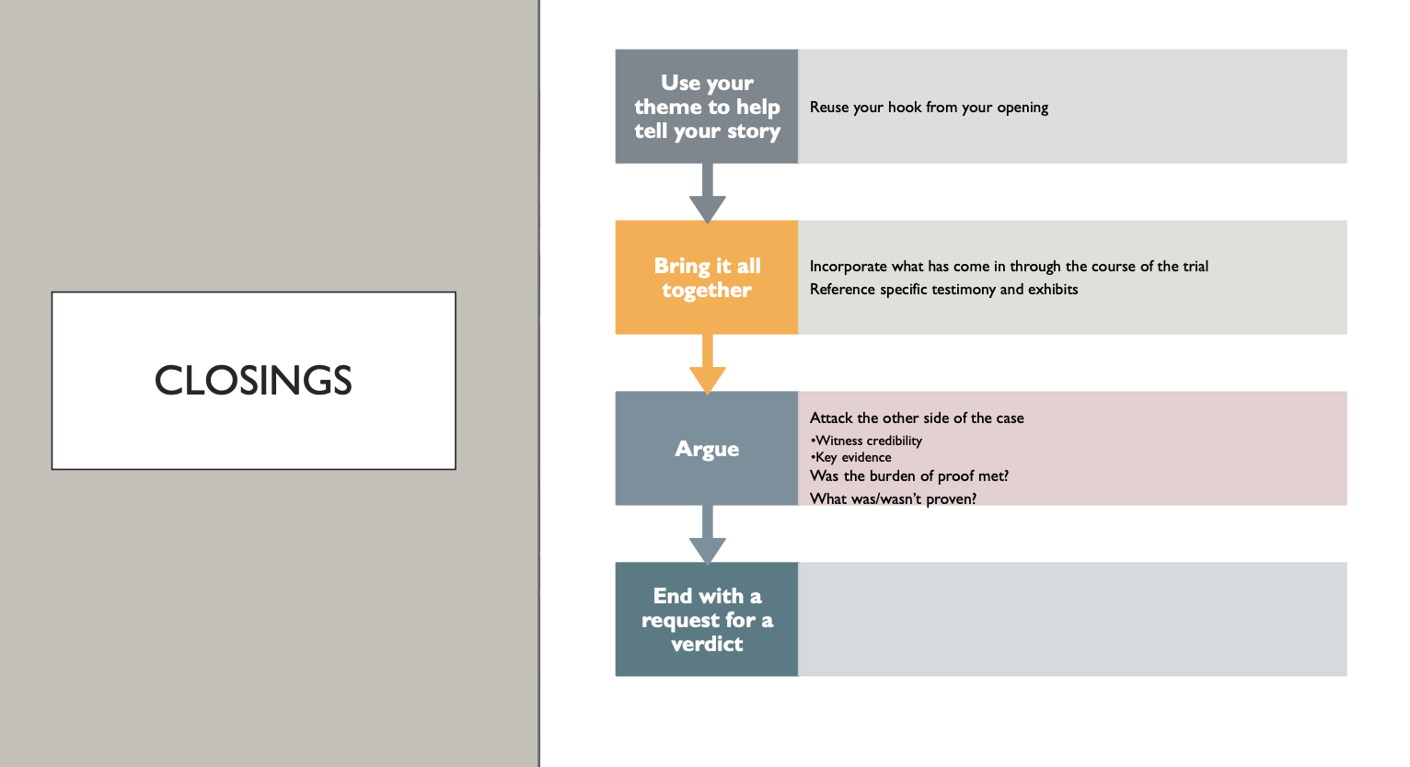
12:30
Witnesses can be anyone; they don’t have to know anything about law!
Thank you to our sponsors!

Slide 17
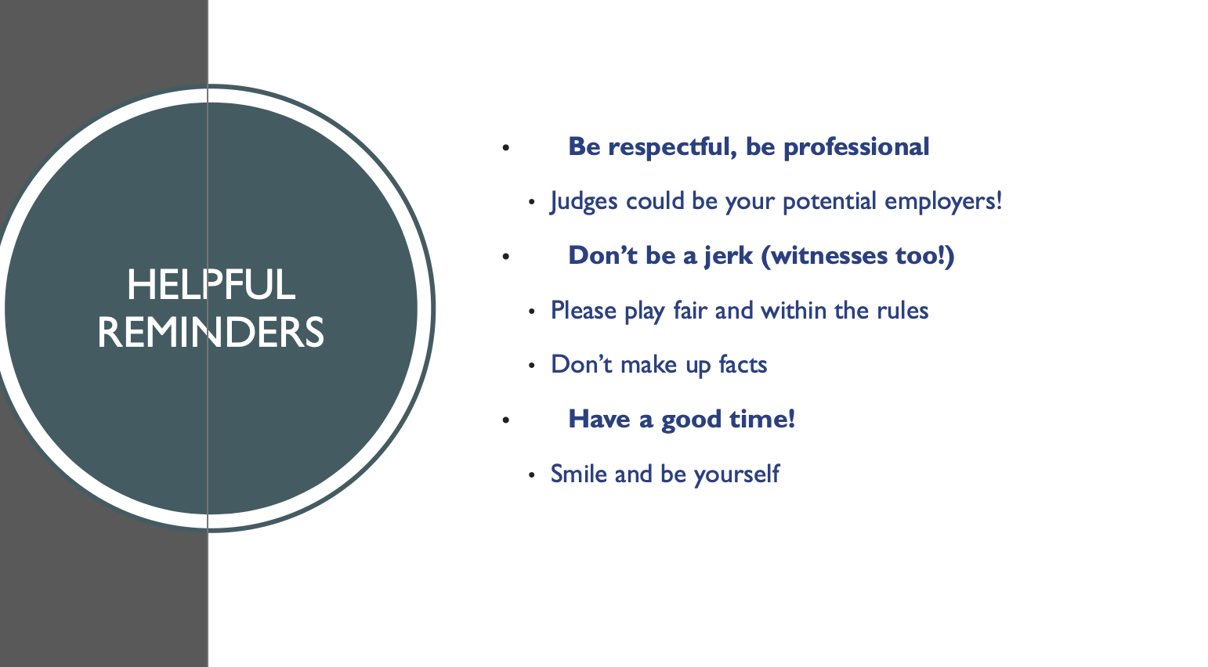
12:30
Witnesses can be anyone; they don’t have to know anything about law!
Thank you to our sponsors!

Slide 18

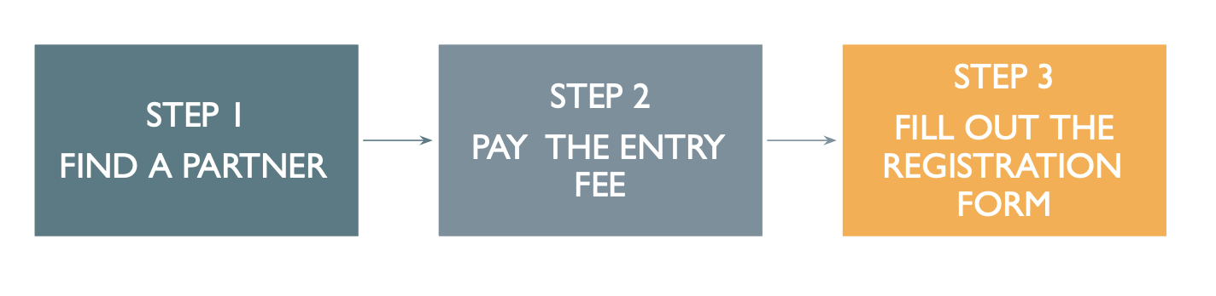
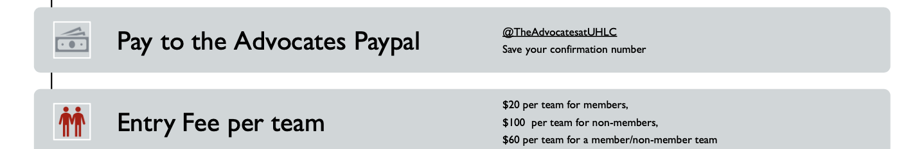
12:30
Witnesses can be anyone; they don’t have to know anything about law!
Thank you to our sponsors!

Slide 19
12:30
Witnesses can be anyone; they don’t have to know anything about law!
Thank you to our sponsors!

Slide 20
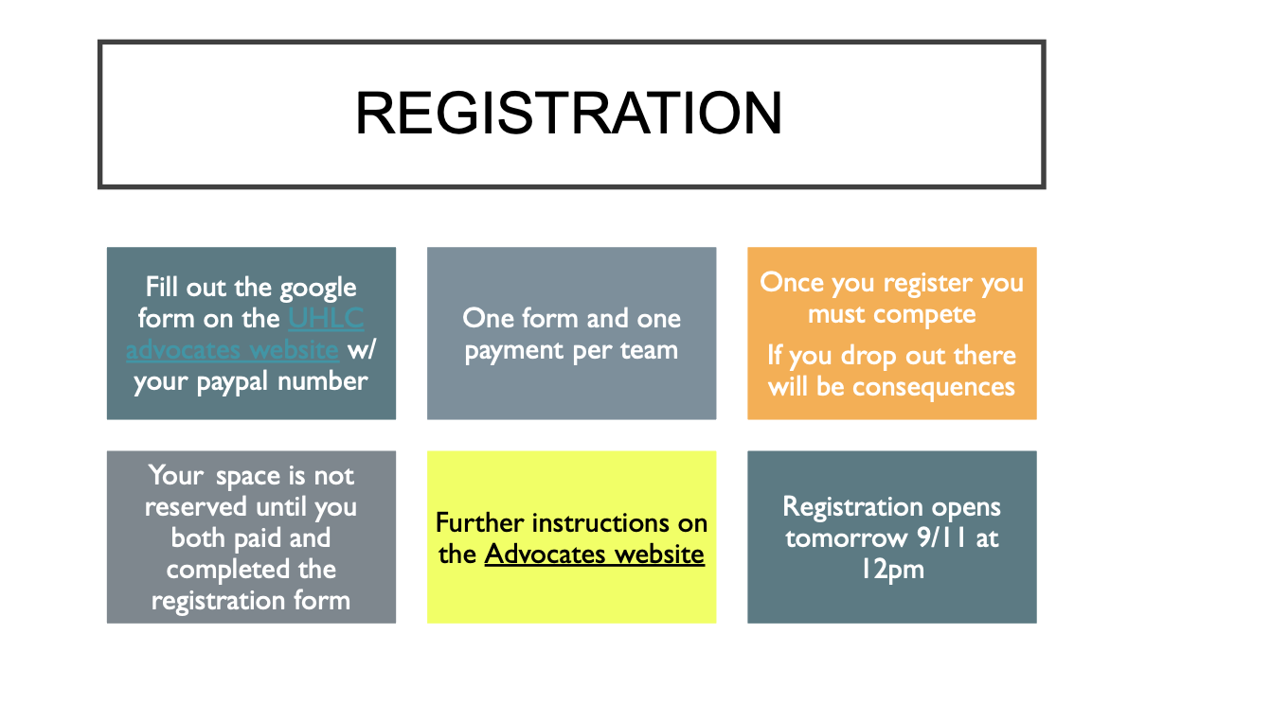
Thank you to our sponsors!

Slide 21
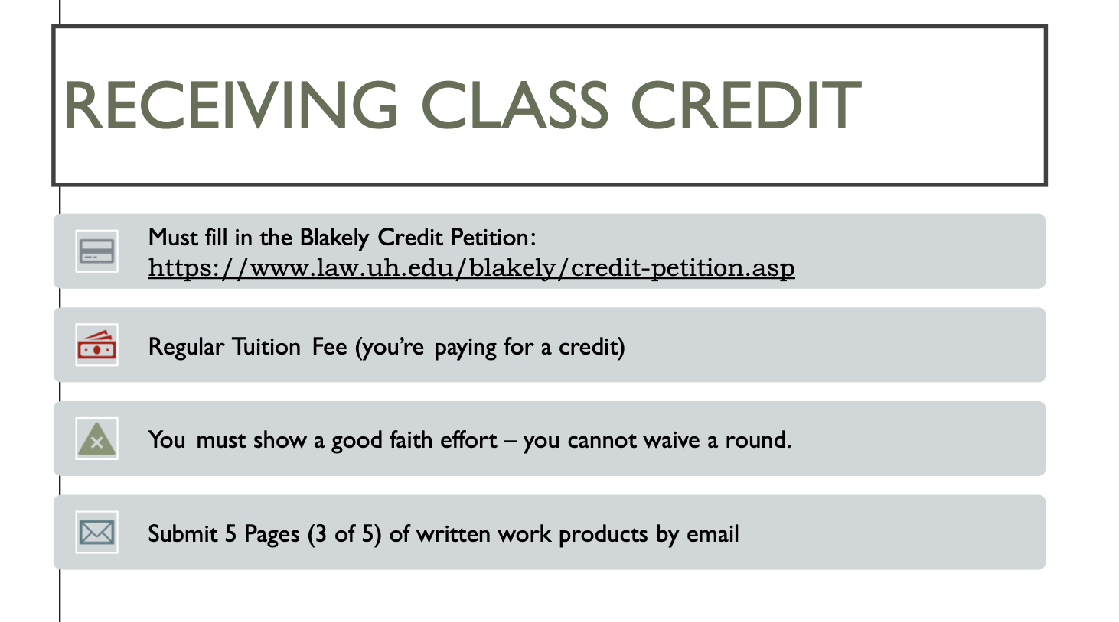
Thank you to our sponsors!

Slide 22
Thank you to our sponsors!

Slide 23
Thank you to our sponsors!

Slide 24
Thank you to our sponsors!
Thank you for being here!

